Slide 1
Building a Canvas App with a Shopping Cart
Notes:
This module examines building a canvas app which allows users to browse a set of products and to add products into a shopping cart tracked using a local collection. Students will learn how to implement the required data access behavior for writing the shopping cart data out to an Azure SQL database or to a SharePoint list. The module examines techniques required to update data across two tables at once for scenarios where adding an Order record also requires adding multiple OrderDetail records with the primary key of the parent Order record. The module concludes with an examination of using PowerApps Studio to create Reusable Components which can be exported and shared across multiple canvas apps.

Slide 2
Agenda
Caching State using Variables and Collections
Using a Collection to Track Shopping Cart Data
Using Patch Instead of an Edit Form
Writing Shopping Cart Data to Back to SharePoint
Designing Reusable Components

Slide 3
Designing with Variables and Collections
Context variables
Created as primitive, record or table at screen scope
Managed using UpdateContext and Navigate
Global variables
Created as primitive, record or table at app scope
Created and managed using Set function
Collections
Created as tables at app scope
Managed using Collect, Clear and ClearCollect
Can be stored to local device using SaveData & LoadData
Notes:
In order to design and implement canvas apps with real-world functionality, you must learn to track application state using context variables, global variables and collections. The value assigned to a context variable or a global variable can be a primitive value, a record or a table. Collections, on the other hand, are always created as tables.
Context variables are local to a single screen. When you call the Navigate function, you can pass a a parameter containing a record which makes it possible to initialize context variables on the target screen. When you write behavior formulas for control properties within a specific screen, you can also create or update context variables by calling UpdateContext.
Global variables are different than context variables because they can be read or updated using formulas on any screen. You create global variables using the Set function.
Collections are a specialized type of global variable that can only hold a table or a blank value. You can create and update collections using the Collect function and the ClearCollect function. You can remove all the records from a table using the Clear function. The features available with Collections go beyond what's available for context variable and global variables because you can use the SaveData function and the LoadData function to persist and load collection data when a canvas app is run on a mobile device. Therefore, collections provide functionality in canvas apps which can be used to create an offline experience.

Slide 4
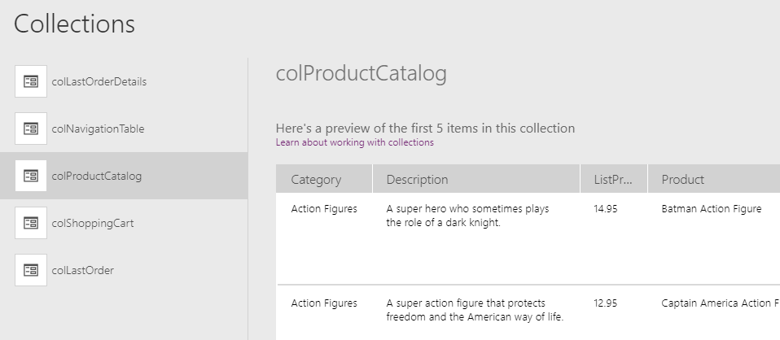
Code Naming Conventions
Consistent naming conventions for variables & collections
Names should indicate type, purpose and scope
Collection names start with col such as colProductCatalog
Global variable names start with gbl such as gblCustomApiUrl
Context variables start with loc such as locCustomerFilter
Notes:
When you create variables and collections, it is recommended you use consistent naming conventions which indicate their type, purpose and scope. You can use the following naming conventions unless you have something else you like better.
- Collection names should start with col (e.g colProductCatalog)
- Global variable names start with gbl (e.g. gblCustomApiUrl)
- Context variables start should with loc (e.g. locCustomerFilter)

Slide 5
Designing Canvas Apps using Collections
Browse Products Screen allows user to build collection
Submit Order Screen allows user to save to SharePoint
Browse Products Screen
colShoppingCart (local collection)
No | Product | ListPrice | Total
1 | Product 1 | 2.95 | 2.95
2 | Product 2 | 4.95 | 9.90
colShoppingCart (local collection)
Submit
Order
Screen
OrderDetails (SharePoint List)
No | Product | ListPrice | Total
1 | Product 1 | 2.95 | 2.95
2 | Product 2 | 4.95 | 9.90
No | Product | ListPrice | Total
1 | Product 1 | 2.95 | 2.95
2 | Product 2 | 4.95 | 9.90
Notes:
In the lab exercises associated with this training module, you will continue to work on the canvas app named Customer Ordering and you will extend the behavior of this canvas app to provide a shopping cart experience. This will give you a chance to implement the behavior you need using collections.
In the Customer Ordering canvas app, you will add a screen named Browse Products Screen which allows to user to select products and a second screen named Submit Order Screen which allows users to submit an order with the products they have selected. You will implement behavior behind the Browse Products Screen to add records to a collection named colShoppingCart whenever the user selects a product and quantity. Then you will implement behavior behind the Submit Order Screen to read the items from colShoppingCart and write then into a SharePoint list.

Slide 6
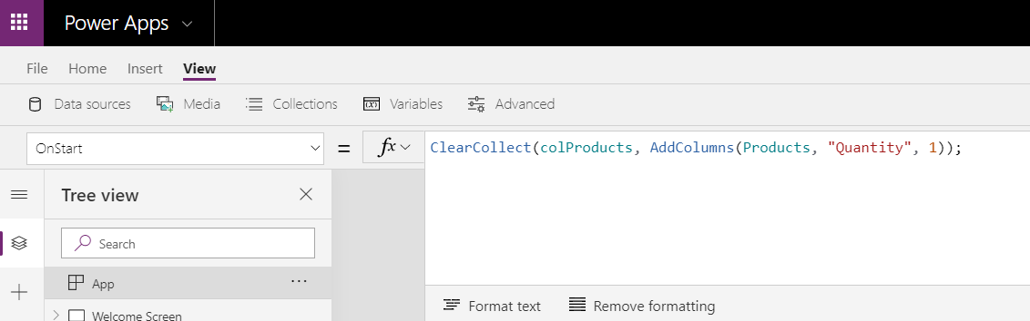
App OnStart
App OnStart property used to initialize state in app
Event provides support for initializing state in app at startup
Commonly used to initialize global variables and collections
Right-click App in left navigation to run OnStart while in editor
Notes:
The App object provide an OnStart property that can be used to initialize global variables and collections when a canvas apps starts up. The OnStart event property is often used to initialize variable values and to pre-load data from an external data source such as a database.
If you are dealing with a small table from an external datasource such as the Products list in the Customer Ordering app, you can optimize performance by loading the entire table into a collection (e.g. colProductList) when the application starts up. After that, you can bind a Gallery control to the collection instead of binding to the table in the external datasource. This can provide an optimization because you don't have to continually retrieve the same data for the products table over the lifetime of the application.

Slide 7
Agenda
Caching State using Variables and Collections
Using a Collection to Track Shopping Cart Data
Using Patch Instead of an Edit Form
Writing Shopping Cart Data to Back to SharePoint
Designing Reusable Components

Slide 8
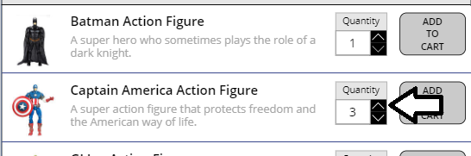
Updatable Collection Columns
Often helpful to add updatable column to collections
Columns updated using calls to Patch
Notes:
When you continue working on the Customer Ordering canvas app in the following lab, you must deal with a tricky design issue. You will be required to display a gallery showing products which allows the user to modify a Quantity value on a product-by-product basis. However, you cannot use a context variable or a global variable because they cannot be used to track a separate Quantity value for each product.
The solution to this problem involves loading the SharePoint Products list into a collection named colProductCatalog and adding a extra updatable column named Quantity. The formula shown at the top of the slide demonstrates how to accomplish this.
You can use the Patch function to update a column for a record in a collection. The two formulas shown at the bottom of the slide demonstrate how to use the Patch function to increment or decrement the product-specific quantity by a value of 1.

Slide 9
Designing A UI Experience with a Shopping Cart

Slide 10
Agenda
Caching State using Variables and Collections
Using a Collection to Track Shopping Cart Data
Using Patch Instead of an Edit Form
Writing Shopping Cart Data to Back to SharePoint
Designing Reusable Components

Slide 11
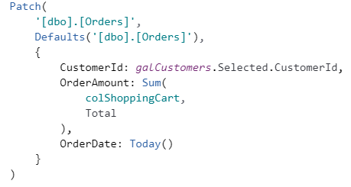
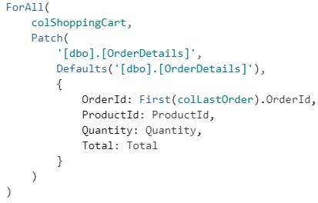
Using Patch Instead of an Edit Form
Sometimes edit forms are not the best option
Patch function used to create and update records in data source
Patch function can be used with ForAll to insert multiple records
Notes:
In simple scenarios, you can build canvas app screens using Edit Form controls to add new records and to edit existing records. However, as the scenario you are dealing with becomes more complicated, you might that Edit Form controls don't provide the flexibility you need to achieve the desired results. This is the case for Submit Order Screen in the Customer Ordering which must coordinate adding items between two list. More specifically, submitting an order will require adding one item to the Orders list and then one item to the OrderDetails list for each product in colShoppingCart.
Adding and updating records with the Patch function provides an alternative to Edit Form controls with greater flexibility. You can combine multiple calls to Patch in the formula for an event property when you require multiple updates in response to a user action such as submitting an order. You can also nest a call to Patch function inside the ForAll function as shown above on the slide. This makes it possible to the Patch function once for each record in the collection named colShoppingCart.

Slide 12
Agenda
Caching State using Variables and Collections
Using a Collection to Track Shopping Cart Data
Using Patch Instead of an Edit Form
Writing Shopping Cart Data to Back to SharePoint
Designing Reusable Components

Slide 13
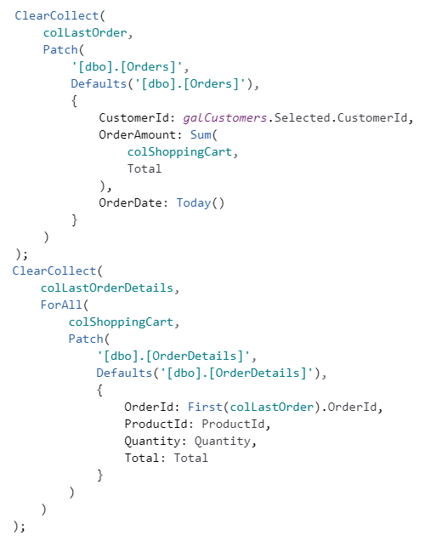


Capturing Return Value from Patch
colLastOrder
colLastOrderDetails
Notes:
It is important to understand that the Patch function has a very useful return value. When you call the Patch function to add a new SharePoint list item, the function returns a table with a single record containing the data for the new item. This provides you with an opportunity to retrieve the SharePoint list item ID that is generated by SharePoint whenever it creates a new list item.
The formula shown in the slide above demonstrates how to submit an order in the Customer Ordering app. The first call to Patch adds a new item to the SharePoint Orders list and its return value is stored in a collection named colLastOrder using a call to ClearCollect. The second call to ClearCollect contains a call to ForAll which executes the Patch function once for each record in colShoppingCart. A key point is that a new Order ID can be determined using the formula First(colLastOrder).OrderId. It is important to retrieve the new order ID because it's value must be passed in the calls to Patch when creating releated items in the OrderDetails list.

Slide 14
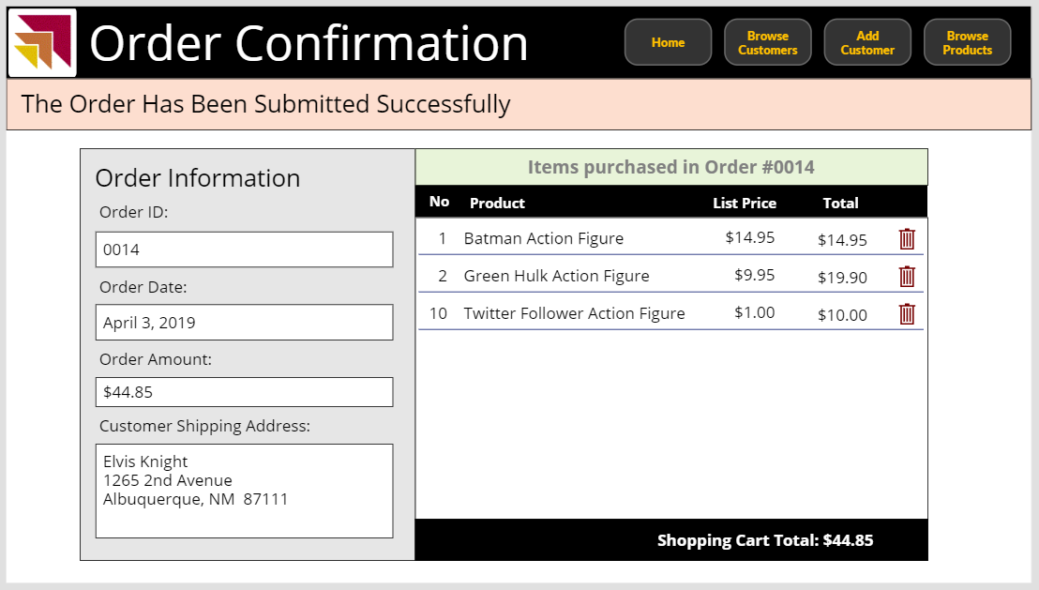
Populating UI from Cached State
colLastOrder
colLastOrderDetails
Notes:
In the Customer Ordering app you will create several collections named colShoppingCart, colLastOrder and colLastOrderDetails. Which of these collections should you use to display the details of an order thay has just been successfully submitted?
When you implement the Order Confirmation Screen of the Customer Ordering app, you will use the data in the colLastOrder collection and the colLastOrderDetails collection to display data to the user. While you might be tempted to display order submission details using data in the colShoppingCart collection, it's not a good idea. The colShoppingCart collection contains the data you attempted to write to SharePoint. But you really don't get a guarantee that the data in colShoppingCart has been successfully added to SharePoint. The benefit of using the data in the colLastOrder collection and the colLastOrderDetails collection is that you get the guarantee that this data has been successfully added to SharePoint.

Slide 15
Writing Orders and Order Details to SharePoint using Patch

Slide 16
Agenda
Caching State using Variables and Collections
Using a Collection to Track Shopping Cart Data
Writing Shopping Cart Data to Back to SharePoint
Designing Reusable Components

Slide 17
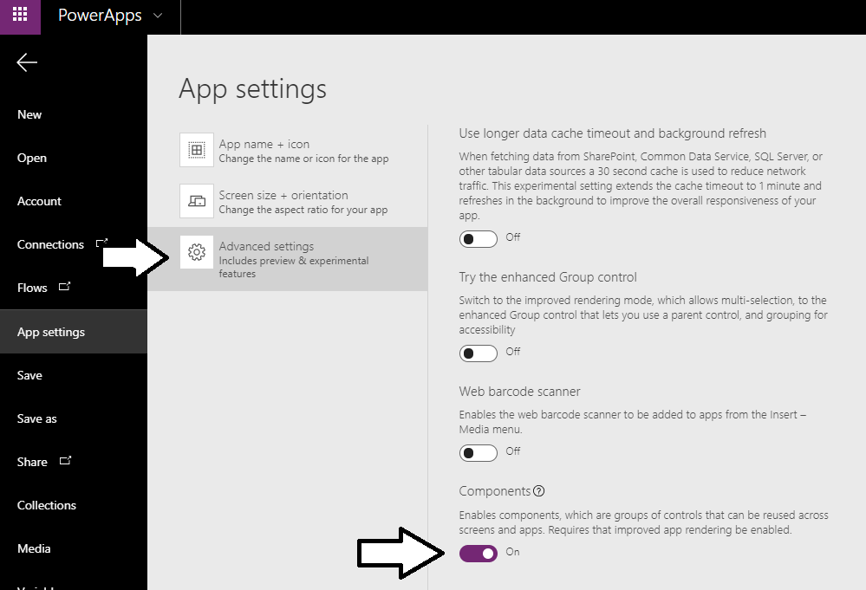
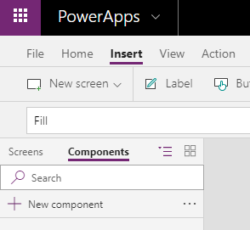
Enabling Components in a Canvas App
Notes:
There is an experimental preview feature for canvas apps which allow you to add and work with reusable components in canvas app projects. You can enable this feature by configuring the Components setting for a canvas app which is available in the File > App settings > Advanced settings section.
Once you enable the Components setting for a canvas app project, you will see a Components tab at he top of the left tree view navigation menu. If you activate the Components tab, you will see a New component command that allows you to add a new component to your project.

Slide 18
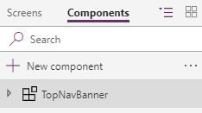
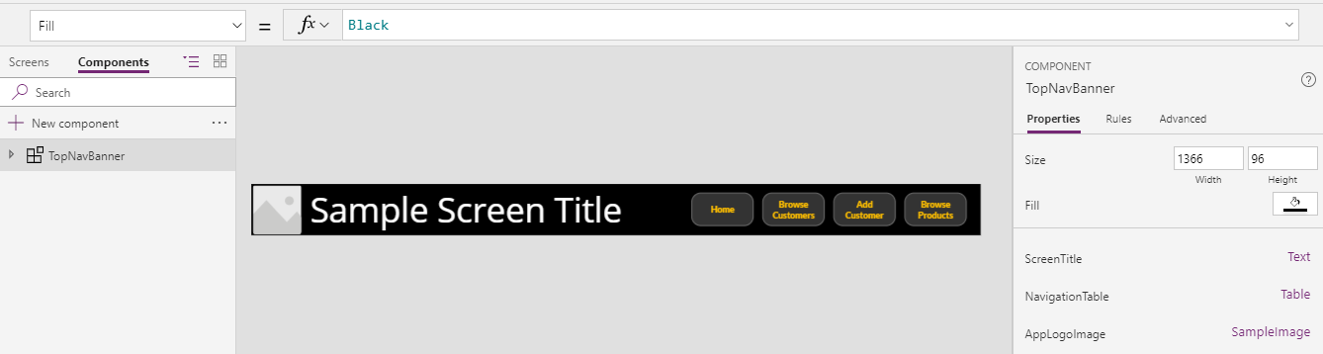
Designing Components
Steps to using components
Create new component
Add component properties
Implement component UI and behavior
Add component to screens in your canvas apps
Notes:
Once you have create a new component, the first step in designing the component is to add component properties. Component properties can be defined as either input properties or output properties and provide the ability to pass data between the component and the hosting canvas app. After you have added the properties required by your component, you implement its appearance and behavior by adding controls and control property formulas just as you do build a screen.
Once you have created a component, you can then add instances of the component to the screens in the hosting canvas app. You can add more than one install of a component in a canvas app. For example, you can use a component to create a global navigation menu by creating one instance of the component on each screen where you want to display the global navigation menu.

Slide 19
Summary
Caching State using Variables and Collections
Using a Collection to Track Shopping Cart Data
Writing Shopping Cart Data to Back to SharePoint
Designing Reusable Components

